Slide 1


6124.TT
業強科技股份有限公司
Yeh-Chiang Technology Corp.
Coporate Presentation
2022
Invest-shareholders-contact：Spokesperson Selina Chiu
E-mail：Selina_Chiu@yctc.com.tw
TEL：02-26551166
Copyright© YCTC. All Rights Reserved

Slide 2
Safe Harbor Notice
This presentation may contain forward looking statements subject to significant risks, uncertainties and actual results may differ materially from those contained in the forward looking statement. Information in this presentation should not be considered as advice or a recommendation to investors in relation to investment objectives and decisions. None of the Company nor any of its respective affiliates, advisors or representatives shall have any liability. Readers are cautioned not to place undue reliance on forward looking statements. The Company does not undertake any obligation to update any forward-looking statement, whether as a result of new information, future events, or otherwise.
Copyright© YCTC. All Rights Reserved

Slide 3
一、About Us
二、Industry Overview
三、Market Outlook
四、Financial Performance
五、Q&A
Copyright© YCTC. All Rights Reserved

Slide 4

一、About Us
Copyright© YCTC. All Rights Reserved

Slide 5
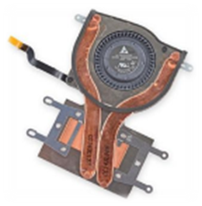
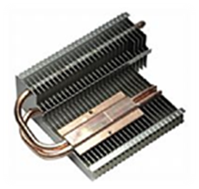
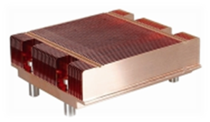
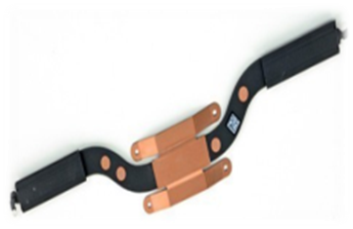
Established：1994.12.23
IPO：1996
List on GTSM： 2002
Chairman ：Tai-Kuang Wang
General Manager：Tai-Kuang Wang
Capital：NT$1.825 billion
Employees：2,635(2022/03/31)
Copyright© YCTC. All Rights Reserved

Slide 6
Copyright© YCTC. All Rights Reserved

Slide 7
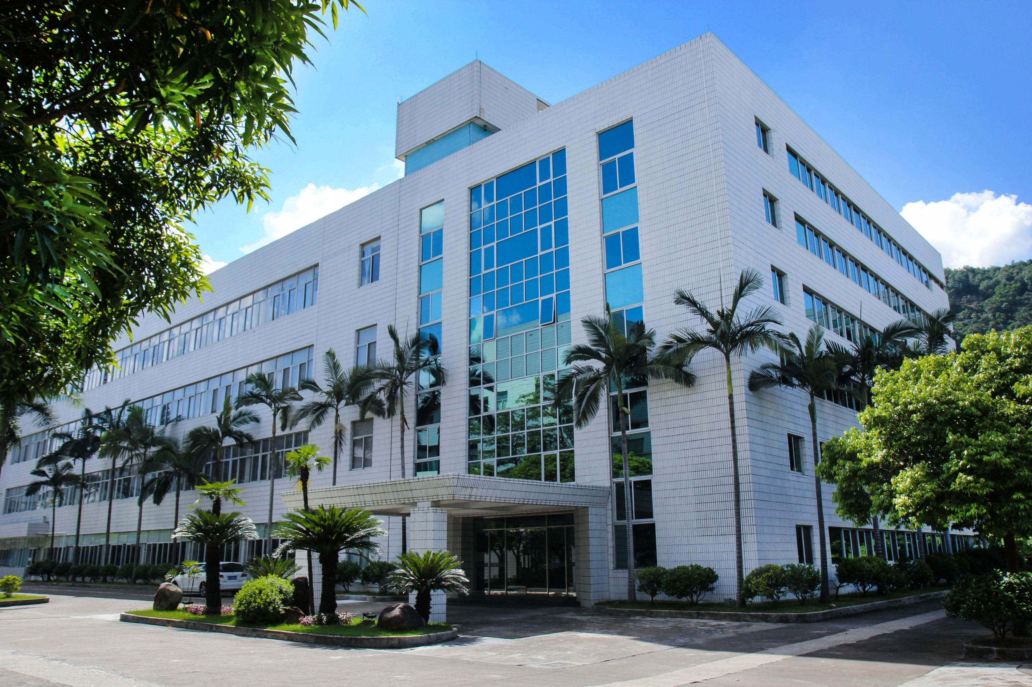
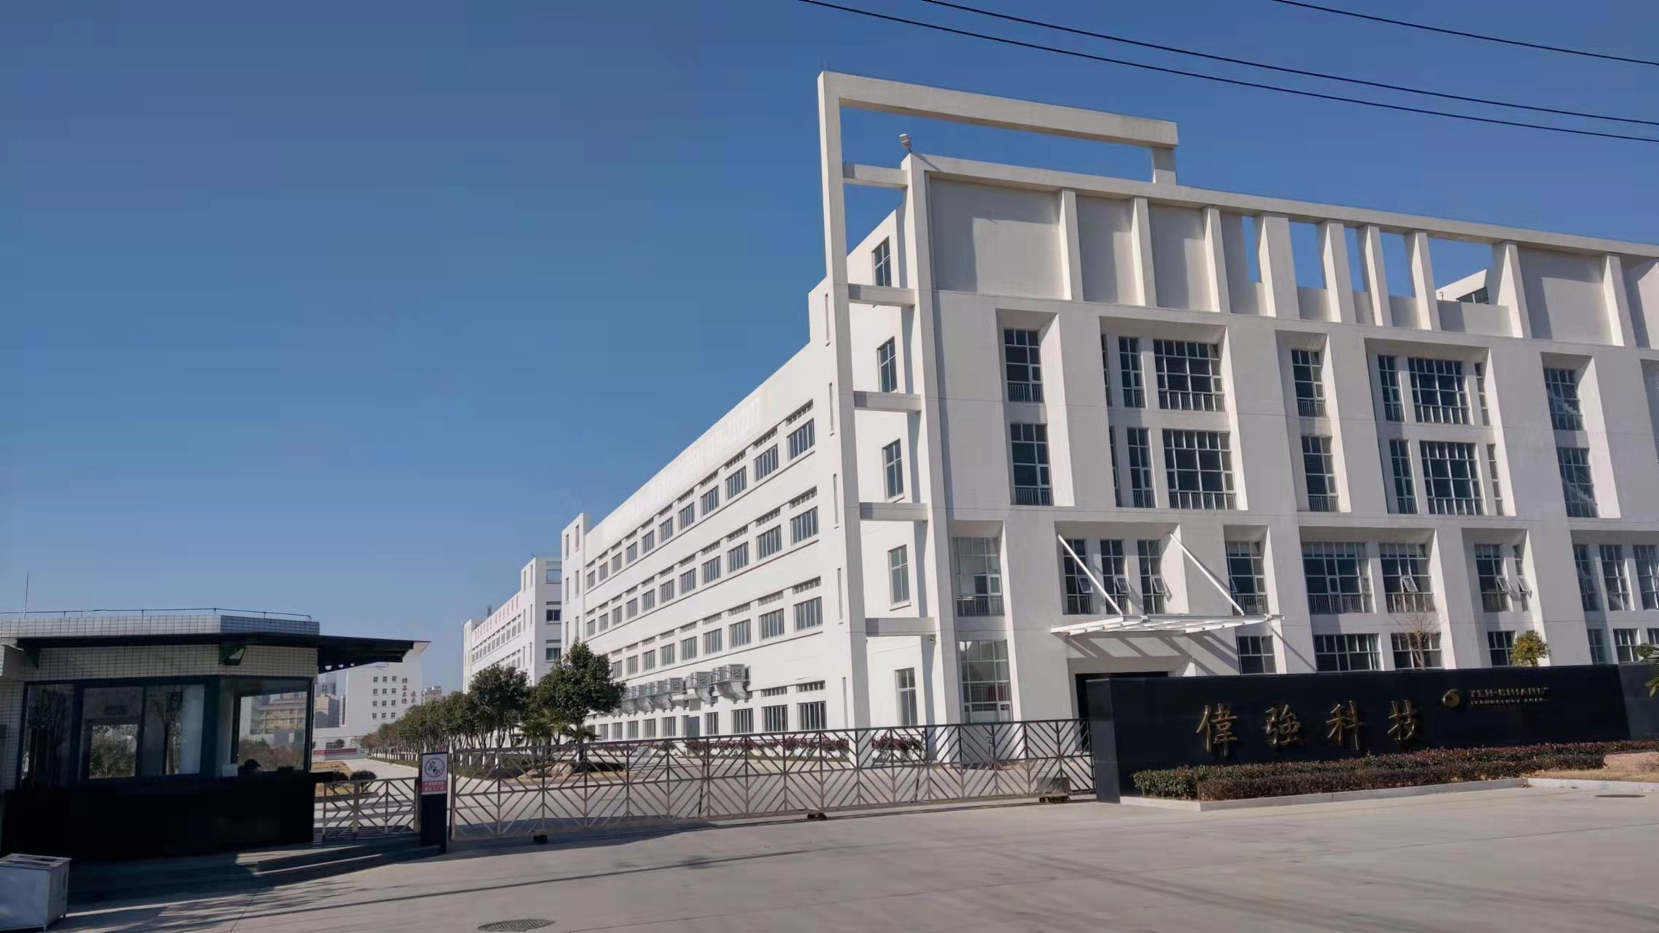
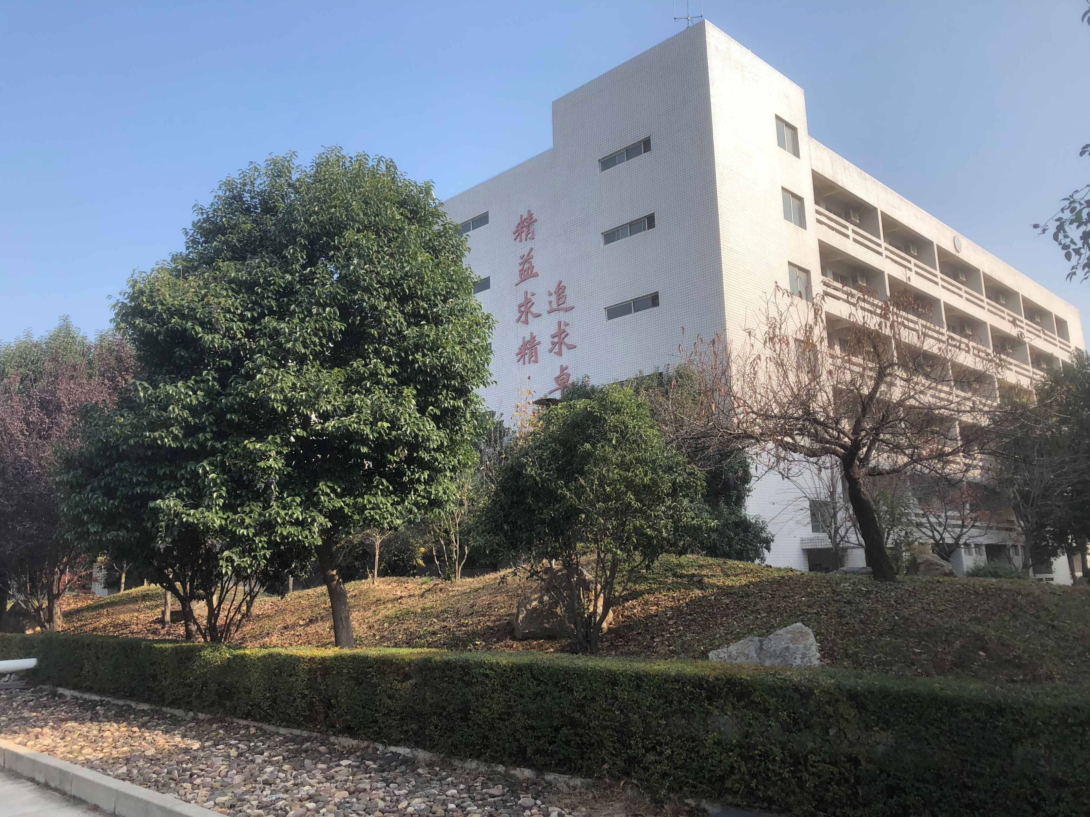
Factory Overview
Zhongshan Weiqiang Technology Co., Ltd.： Zhongshan City, Guangdong.
Yexian Weiqiang Technology Co., Ltd.： Pingdingshan City,Henan.
Pingdingshan Yeqiang Technology Co., Ltd.： Pingdingshan City,Henan.
Zhongshan Weiqiang Technology Co., Ltd.
Yexian Weiqiang Technology Co., Ltd.
Pingdingshan Yeqiang Technology Co., Ltd.
Copyright© YCTC. All Rights Reserved

Slide 8
industry
二、Industry Overview
Copyright© YCTC. All Rights Reserved

Slide 9
Applications of 5G technology
Industry relevance of companies
Trends of Product Development
Copyright© YCTC. All Rights Reserved

Slide 10
三、Market Outlook
Copyright© YCTC. All Rights Reserved

Slide 11
Market Overview
Ultrathin Heat Pipe
Ultrathin Vapor Chamber
Car heat radiation application
Competitive niche and challenges
Unfavorable factors and countermeasures
Favorable factors
Copyright© YCTC. All Rights Reserved

Slide 12
四、Financial Performance
The financial numbers hereby are based on International Financial Reporting Standards(IFRS)
Cumulative consolidated numbers were reviewed by CPA
Copyright© YCTC. All Rights Reserved

Slide 13
Copyright© YCTC. All Rights Reserved

Slide 14
Copyright© YCTC. All Rights Reserved

Slide 15
Conclusion
Copyright© YCTC. All Rights Reserved

Slide 16
五、Q&A
Copyright© YCTC. All Rights Reserved

