Slide 1


6124.TT
Yeh-Chiang Technology Corp.
Coporate Presentation
2024
Invest-shareholders-contact：Spokesperson Wenhow Cheng
E-mail：wenhow_cheng@yctc.com.tw
TEL：02-26551166
Copyright© YCTC. All Rights Reserved

Slide 2
Safe Harbor Notice
This presentation may contain forward looking statements subject to significant risks, uncertainties and actual results may differ materially from those contained in the forward looking statement. Information in this presentation should not be considered as advice or a recommendation to investors in relation to investment objectives and decisions. None of the Company nor any of its respective affiliates, advisors or representatives shall have any liability. Readers are cautioned not to place undue reliance on forward looking statements. The Company does not undertake any obligation to update any forward-looking statement, whether as a result of new information, future events, or otherwise.
Copyright© YCTC. All Rights Reserved

Slide 3
1、About Us
2、Industry Overview
3、Market Outlook
4、Financial Performance
5、Q&A
Copyright© YCTC. All Rights Reserved

Slide 4

1、About Us
Copyright© YCTC. All Rights Reserved

Slide 5
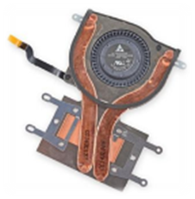
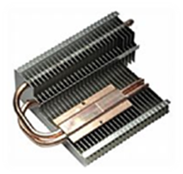
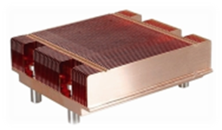
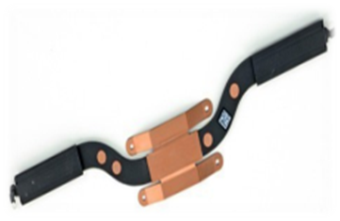
Established：1994.12.23
List on GTSM： 2002(Stock Code: 6124)
Capital：NT$1.825 billion
Industry category：Electronic Parts and Components Manufacturing
ISO27001
（CQC）ISO9001、ISO14001、ISO45001
Employees：2,700(2024/11/25)
Copyright© YCTC. All Rights Reserved

Slide 6
Purchased the land of 1,721 square meter and plant of 1,010.96 square meter on No. 13, Shih-Er Road.
1998
Zhongshan Weiqiang Technology Co., Ltd
2004
Obtained trademark right of “Taiwan Lighting”.& Invested Taiwan Lighting Co., Ltd. for future operating plan of the subsidiary.
2010
Invested So Bright Electronics Co., Ltd. for future operating plan&
Remuneration Committee
2012
Pingdingshan Yeqiang Technology Co., Ltd. & Yexian Weiqiang Technology Co., Ltd.
2013&2014
Yexian Weiqiang extended plant, and equipment
2017&2018
Vietnam Yeh-Chiang Technology Company Limited
2020
Copyright© YCTC. All Rights Reserved

Slide 7
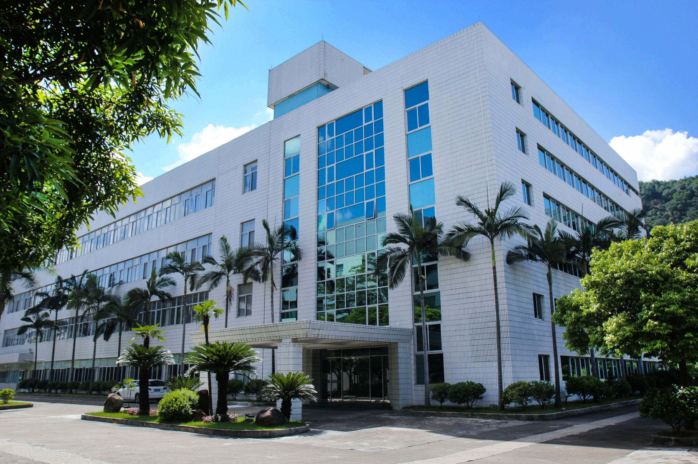
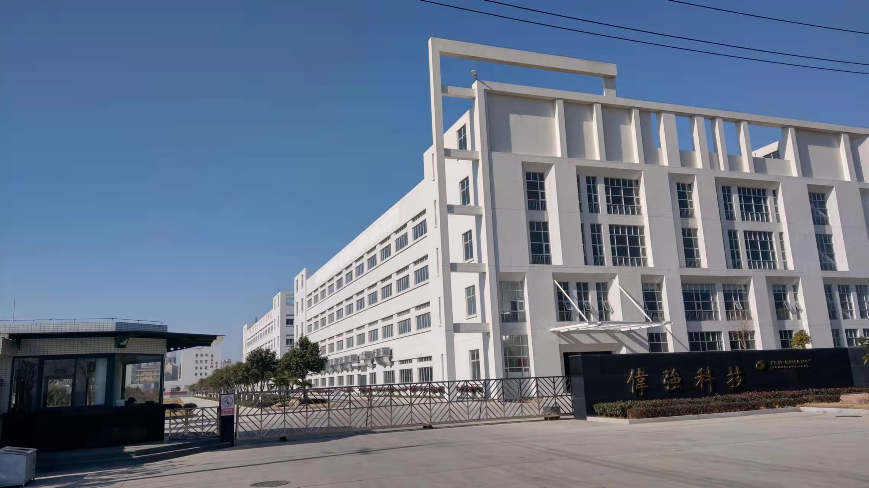
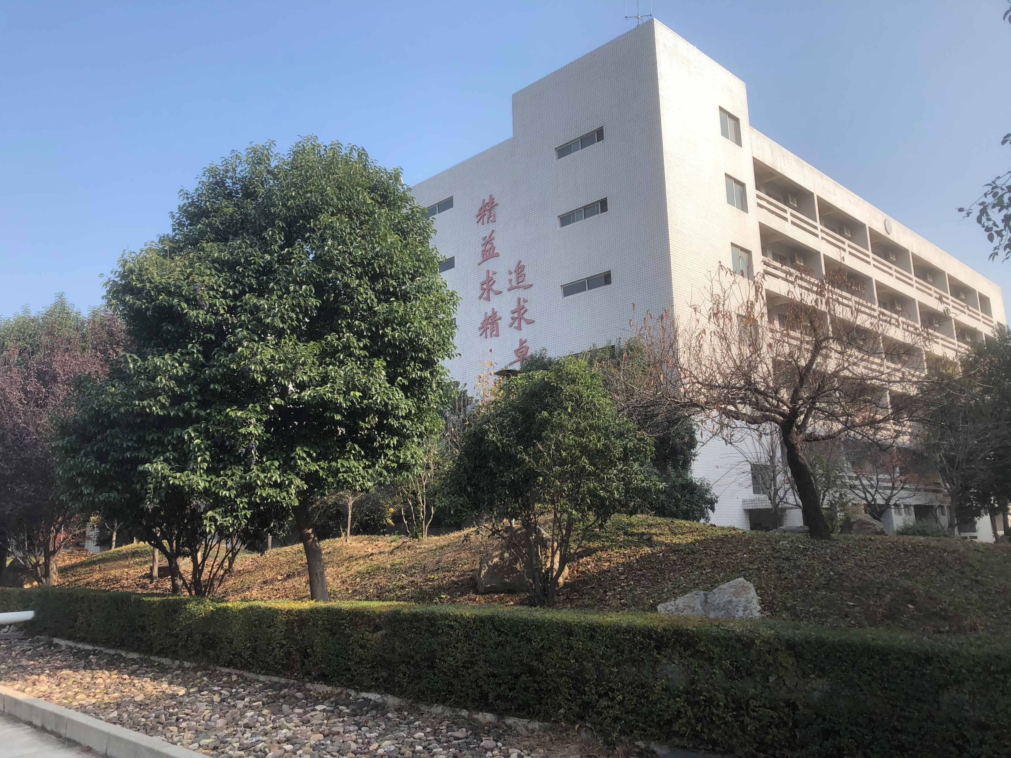
Factory Overview
Zhongshan Weiqiang Technology Co., Ltd.： Zhongshan City, Guangdong, China
Yexian Weiqiang Technology Co., Ltd.： Pingdingshan City, Henan, China
Pingdingshan Yeqiang Technology Co., Ltd.： Pingdingshan City, Henan, China
Vietnam Yeh-Chiang Technology Co., Ltd.： HALONG CITY, QUANGNINH PROVINCE, VIETNAM
Zhongshan Weiqiang Technology Co., Ltd.
Yexian Weiqiang Technology Co., Ltd.
Pingdingshan Yeqiang Technology Co., Ltd.
Copyright© YCTC. All Rights Reserved

Slide 8
industry
2、Industry Overview
Copyright© YCTC. All Rights Reserved

Slide 9
AI relevant market in the future development.
Copyright© YCTC. All Rights Reserved

Slide 10
3、Market Outlook
Copyright© YCTC. All Rights Reserved

Slide 11
Market Overview
Ultrathin heat pipe for cellphone
Ultrathin vapor chamber for cellphone
Car heat radiation application
Competitive niche and challenges
Unfavorable factors and countermeasures
Favorable factors
Copyright© YCTC. All Rights Reserved

Slide 12
4、Financial Performance
The financial numbers hereby are based on International Financial Reporting Standards(IFRS)
Consolidated Financial Statements were reviewed by CPA
Copyright© YCTC. All Rights Reserved

Slide 13
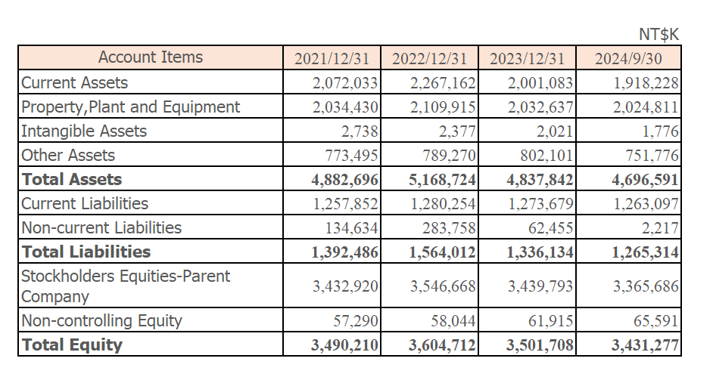
Copyright© YCTC. All Rights Reserved

Slide 14
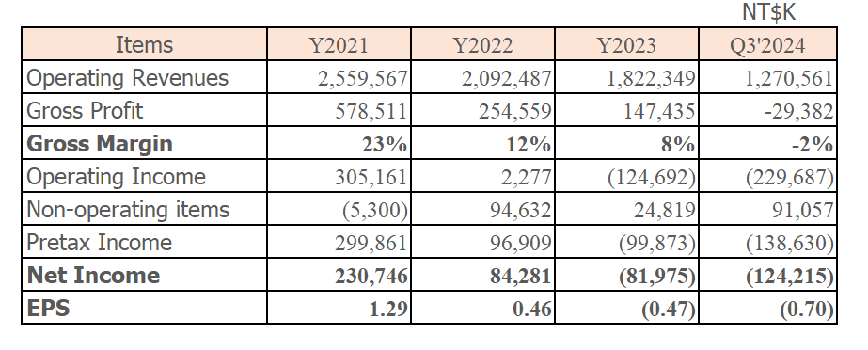
Copyright© YCTC. All Rights Reserved

Slide 15
5、Q&A
Copyright© YCTC. All Rights Reserved

